Slide 1
Module 3 - Security, Privacy, Compliance, and Trust

Slide 2
Describe Azure directory services
Azure Active Directory (Azure AD) is a directory service that enables you to sign in and access both Microsoft cloud applications and cloud applications that you develop.
Azure AD can also help you maintain your on-premises Active Directory deployment.
For on-premises environments, Active Directory running on Windows Server provides an identity and access management service that's managed by your organization.
Azure AD is Microsoft's cloud-based identity and access management service.
With Azure AD, you control the identity accounts, but Microsoft ensures that the service is available globally

Slide 3
Who uses Azure AD?
Azure AD is for:
IT administrators. Administrators can use Azure AD to control access to applications and resources based on their business requirements.
App developers. Developers can use Azure AD to provide a standards-based approach for adding functionality to applications that they build, such as adding SSO functionality to an app or enabling an app to work with a user's existing credentials.
Users. Users can manage their identities and take maintenance actions like self-service password reset.
Online service subscribers. Microsoft 365, Microsoft Office 365, Azure, and Microsoft Dynamics CRM Online subscribers are already using Azure AD to authenticate into their account.

Slide 4
What does Azure AD do?
Authentication: This includes verifying identity to access applications and resources. It also includes providing functionality such as self-service password reset, multifactor authentication, a custom list of banned passwords, and smart lockout services. Ex: password and OTP
Single sign-on: Single sign-on (SSO) enables you to remember only one username and one password to access multiple applications. A single identity is tied to a user, which simplifies the security model. As users change roles or leave an organization, access modifications are tied to that identity, which greatly reduces the effort needed to change or disable accounts. EX: One Login for all apps like Google.
Application management: You can manage your cloud and on-premises apps by using Azure AD. Features like Application Proxy, SaaS apps, the My Apps portal, and single sign-on provide a better user experience. Ex:Email, Calendering and office tools.
Device management: Along with accounts for individual people, Azure AD supports the registration of devices. Registration enables devices to be managed through tools like Microsoft Intune. It also allows for device-based Conditional Access policies to restrict access attempts to only those coming from known devices, regardless of the requesting user account. Ex: Linked devices Whatsapp

Slide 5
Describe Azure authentication methods
Authentication is the process of establishing the identity of a person, service, or device. It requires the person, service, or device to provide some type of credential to prove who they are.
Authentication is like presenting ID when you’re traveling. It doesn’t confirm that you’re ticketed, it just proves that you're who you say you are. Azure supports multiple authentication methods, including standard passwords, single sign-on (SSO), multifactor authentication (MFA), and passwordless.

Slide 6
What's single sign-on?
Single sign-on (SSO) enables a user to sign in one time and use that credential to access multiple resources and applications from different providers.
For SSO to work, the different applications and providers must trust the initial authenticator.
More identities mean more passwords to remember and change. Password policies can vary among applications.
As complexity requirements increase, it becomes increasingly difficult for users to remember them. The more passwords a user has to manage, the greater the risk of a credential-related security incident.
Consider the process of managing all those identities. More strain is placed on help desks as they deal with account lockouts and password reset requests. If a user leaves an organization, tracking down all those identities and ensuring they're disabled can be challenging. If an identity is overlooked, this might allow access when it should have been eliminated.
With SSO, you need to remember only one ID and one password. Access across applications is granted to a single identity that's tied to the user, which simplifies the security model.
As users change roles or leave an organization, access is tied to a single identity. This change greatly reduces the effort needed to change or disable accounts. Using SSO for accounts makes it easier for users to manage their identities and for IT to manage users.

Slide 7
What’s Multifactor Authentication?
Multifactor authentication is the process of prompting a user for an extra form (or factor) of identification during the sign-in process. MFA helps protect against a password compromise in situations where the password was compromised but the second factor wasn't.
Think about how you sign into websites, email, or online services. After entering your username and password, have you ever needed to enter a code that was sent to your phone? If so, you've used multifactor authentication to sign in.
Multifactor authentication provides additional security for your identities by requiring two or more elements to fully authenticate. These elements fall into three categories:
Something the user knows – this might be a challenge question.
Something the user has – this might be a code that's sent to the user's mobile phone.
Something the user is – this is typically some sort of biometric property, such as a fingerprint or face scan.
Multifactor authentication increases identity security by limiting the impact of credential exposure (for example, stolen usernames and passwords). With multifactor authentication enabled, an attacker who has a user's password would also need to have possession of their phone or their fingerprint to fully authenticate.
Compare multifactor authentication with single-factor authentication. Under single-factor authentication, an attacker would need only a username and password to authenticate. Multifactor authentication should be enabled wherever possible because it adds enormous benefits to security.

Slide 8
What's Azure AD Multi-Factor Authentication?
Azure AD Multi-Factor Authentication is a Microsoft service that provides multifactor authentication capabilities. Azure AD Multi-Factor Authentication enables users to choose an additional form of authentication during sign-in, such as a phone call or mobile app notification.
What’s passwordless authentication?
Features like MFA are a great way to secure your organization, but users often get frustrated with the additional security layer on top of having to remember their passwords. People are more likely to comply when it's easy and convenient to do so. Passwordless authentication methods are more convenient because the password is removed and replaced with something you have, plus something you are, or something you know.
Passwordless authentication needs to be set up on a device before it can work. For example, your computer is something you have. Once it’s been registered or enrolled, Azure now knows that it’s associated with you. Now that the computer is known, once you provide something you know or are (such as a PIN or fingerprint), you can be authenticated without using a password.
Each organization has different needs when it comes to authentication. Microsoft global Azure and Azure Government offer the following three passwordless authentication options that integrate with Azure Active Directory (Azure AD):
Windows Hello for Business
Microsoft Authenticator app
FIDO2 security keys

Slide 9
Describe Azure RBAC(role-based access control)
When you have multiple IT and engineering teams, how can you control what access they have to the resources in your cloud environment?
The principle of least privilege says you should only grant access up to the level needed to complete a task. If you only need read access to a storage blob, then you should only be granted read access to that storage blob. Write access to that blob shouldn’t be granted, nor should read access to other storage blobs. It’s a good security practice to follow.
However, managing that level of permissions for an entire team would become tedious. Instead of defining the detailed access requirements for each individual, and then updating access requirements when new resources are created or new people join the team, Azure enables you to control access through Azure role-based access control (Azure RBAC).
Azure provides built-in roles that describe common access rules for cloud resources. You can also define your own roles. Each role has an associated set of access permissions that relate to that role. When you assign individuals or groups to one or more roles, they receive all the associated access permissions.
So, if you hire a new engineer and add them to the Azure RBAC group for engineers, they automatically get the same access as the other engineers in the same Azure RBAC group. Similarly, if you add additional resources and point Azure RBAC at them, everyone in that Azure RBAC group will now have those permissions on the new resources as well as the existing resources.

Slide 10

Security, Privacy, Compliance and Trust

Slide 11
Zero Trust and Defence in Depth
Choosing a reliable cybersecurity solution that prevents security breaches and ensures secure remote access to employees is highly important.
With the increasing cybersecurity concerns, organisations have started enforcing network security precautions, mainly because the organisation's infrastructure and facilities are the common targets of cyber attackers.
These cyberattacks and ransomware attacks lead to financial losses for organisations along with reputational damage. Hence, employing the right security strategy to prevent these attacks and ensures the utmost network security is paramount.

Slide 12
Zero Trust and Defence in Depth
What is Zero Trust?
It is based on the concept of “never trust, always verify.” This cybersecurity framework is based on the idea that no entity – inside or outside of a network – should be implicitly trusted.
Everything and everyone needs to prove who they are and that they have the right permissions to access the target resource. In short, they need to undergo continual authentication, verification and authorization to keep access to applications and data.
This is akin to crew members of the Enterprise verifying and authenticating their identity at every doorway before they are allowed to access the next area.

Slide 13
Zero Trust
Zero trust is a network security model that has more specific principles than those of defense in depth. With zero trust, the goal is to never trust anyone or anything that accesses and communicates with applications and services inside a corporate network.
Zero trust uses the principle of least privilege to ensure that only the correct devices and users connecting to the network, as well as workloads within public and private data centers, are allowed and expected to transmit and receive data.

Slide 14
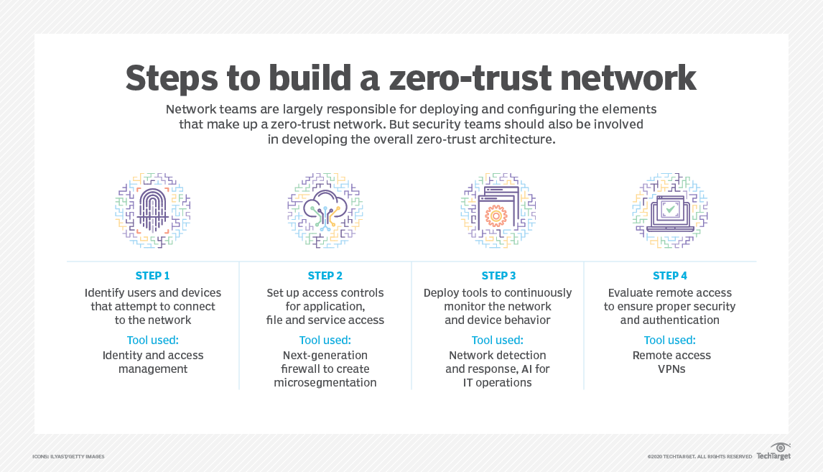

Slide 15
Benefits of zero trust
The benefit of zero trust is contained within the adage of "never trust, verify everything." With zero trust, users must constantly prove they have appropriate permissions, from initial login and thereafter.
This means that, even if attackers infiltrate a system, they can't necessarily do any damage or exfiltrate data.
Despite the restrictive-sounding nature of zero trust, it can boost UX through tools such as single sign-on, reducing the worry around password mismanagement.
UX(User Experience Design) - A person's perceptions and responses that result from the use or anticipated use of a product, system or service
UI (User interface (UI) design) is the process designers use to build interfaces in software or computerized devices, focusing on looks or style.

Slide 16
What is Defence in Depth
Now, defense-in-depth refers to the practice of using layers of security measures, such as firewalls, secured gateways, authentication and intrusion detection systems, to protect internal networks from external attacks.
This provides backup levels of security in case other security measures fail.
With multiple layers of protective devices and processes to keep threat actors outside of the perimeter.
In short, if one defensive measure is compromised, another set of defense mechanisms can detect and prevent a breach attempt.
By including redundancies and using security defenses across solutions, enterprises can aim to close gaps in security and thwart potential attacks.

Slide 17
Defence in Depth
This strategy has been popular over the past few decades for two main reasons:
A layered security approach to tools helps ensure gaps between security policies are fewer and harder to find.
Defense in depth helps protect against human errors that cause misconfiguration to a security tool.
Benefits of defense in depth
The top benefit of defense in depth over zero trust is that, if one part of the layered security fails, other layers in the security architecture are already in place to keep business-critical data safe from attackers.
Layering defenses can also slow down attackers, improving the chances they will be detected by security mechanisms or security teams.

Slide 18
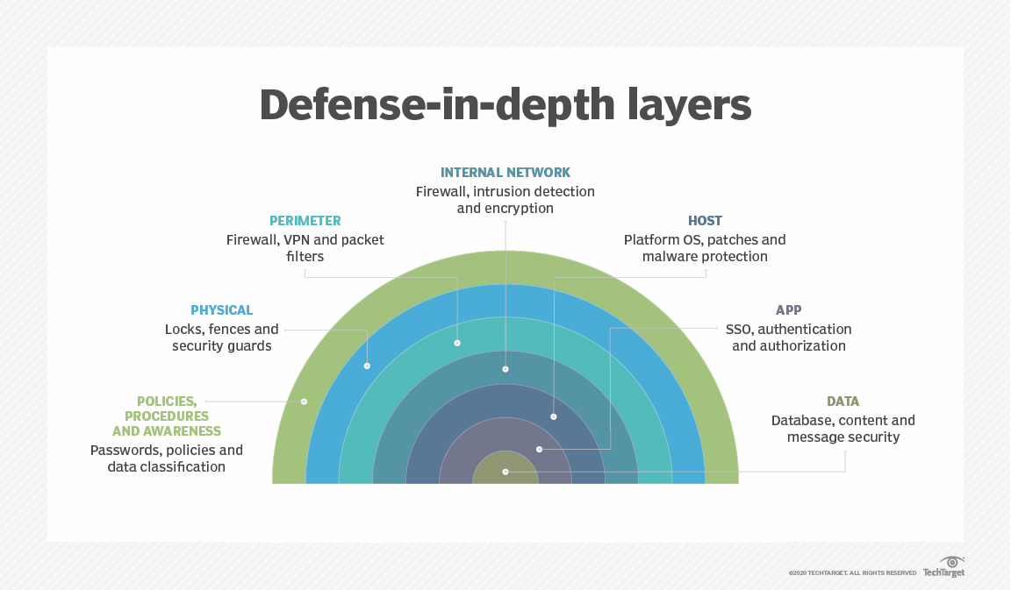
Defence in Depth

Slide 19
Defence in Depth
The physical security layer is the first line of defense to protect computing hardware in the datacenter.
The identity and access layer controls access to infrastructure and change control.
The perimeter layer uses distributed denial of service (DDoS) protection to filter large-scale attacks before they can cause a denial of service for users.
The network layer limits communication between resources through segmentation and access controls.
The compute layer secures access to virtual machines.
The application layer helps ensure that applications are secure and free of security vulnerabilities.
The data layer controls access to business and customer data that you need to protect.

Slide 20
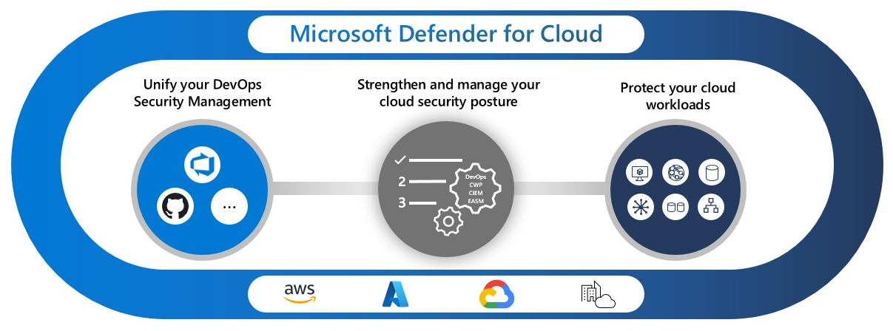
What is Microsoft Defender for Cloud?
Defender for Cloud helps in the prevention, detection, and response to threats and gives visibility into the security surface of the resources. Defender for Cloud is a complete solution with multiple enhanced protection features.

Slide 21
Microsoft Defender for Cloud performs three main actions for the management of security, which are –
Vulnerability Assessment and Management.
Security Hardening by recommending optimized and improved security
Defend resources and workloads by detecting and resolving threats.
Cloud Security Posture Management (CSPM) provides visibility into your current security situation using a secure score and also provides guidance on security hardening.
Cloud Workload Protection (CWP) helps in detecting, analyzing, and resolve threats. Once Microsoft Defender detects a threat on your resources and workloads, it displays alerts on the Azure portal.
It also provides advance threat protection for your VMs, SQL databases, Containers, Web Applications, Network, and more. These protections include securing the management ports of your VMs with just-in-time, and time-bound access, and adaptive application controls for controlling the apps that should run on your machines.

Slide 22
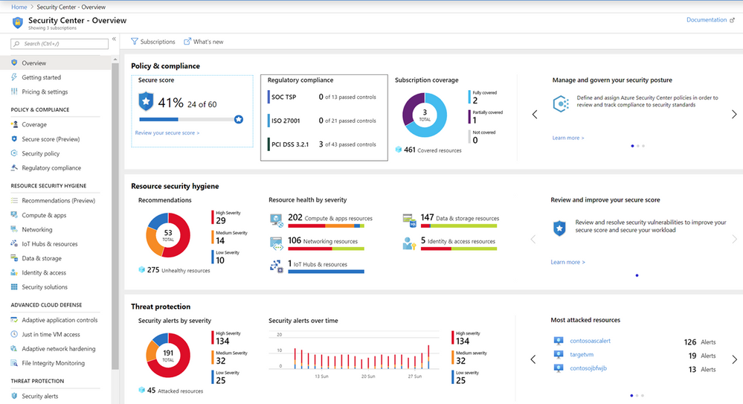

Slide 23
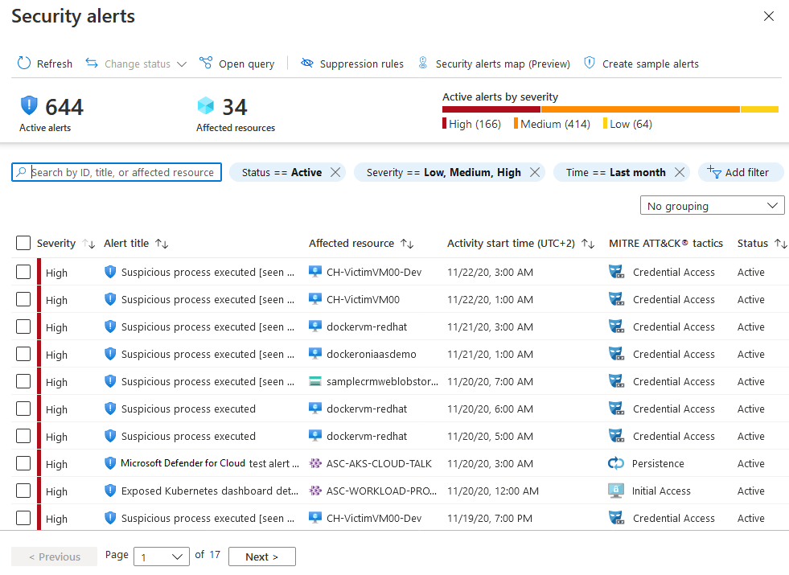

Slide 24
Features and tools in Azure for governance and compliance
Microsoft Azure places a strong emphasis on security, privacy, and trust, providing a robust set of features and tools to ensure that customer data and applications are protected, and compliance with various industry standards and regulations is maintained.
Here's how Azure addresses security, privacy, and trust
1. Data Encryption: Azure offers encryption at rest and in transit to protect data from unauthorized access. Azure Key Vault provides a secure key management solution for safeguarding cryptographic keys used for data encryption.
2. Azure Security Center: Azure Security Center is a centralized security management tool that continuously monitors the security posture of Azure resources. It provides security recommendations and threat detection capabilities to enhance the security of applications and data.
3. Identity and Access Management: Azure Active Directory (Azure AD) allows organizations to manage user identities and access to resources. Multi-factor authentication (MFA) adds an extra layer of security to user sign-ins.
4. Compliance Certifications: Azure maintains a wide range of compliance certifications, including ISO, SOC(Security Operations Center), GDPR-Europe(General Data Protection Regulation), HIPAA-US(he Health Insurance Portability and Accountability Act ), FedRAMP(Federal Risk and Authorization Management Program, and others. These certifications demonstrate adherence to strict security and privacy standards.
5. Azure Policy: Azure Policy helps enforce compliance with organization-specific rules and industry regulations across Azure resources. It allows the definition and enforcement of policies that govern access, configurations, and more.

Slide 25
6. Azure Blueprints: Azure Blueprints facilitate the creation of reusable templates for cloud deployments, including security and compliance policies. This ensures consistent and compliant deployments across the organization.
7. Azure Sentinel: Azure Sentinel is a cloud-native SIEM and SOAR Solution, enabling organizations to detect and respond to security incidents in real-time, promoting better trust and security
SIEM (Security Information and Event Management) - data collection, analytics, and response.
A SIEM’s job is to ingest data across your entire network (data collection), identify malicious behavior (analytics), and provide alerts to security and IT teams to give them the visibility and information to respond before the issue becomes serious (response).
SOAR(Security Orchestration, Automation and Response) - that is used to protect networks and devices from cyber threats, attacks, and unauthorized access. It combines comprehensive data gathering, analytics, and case management to allow organizations to closely integrate their workflow process
8. Azure Data Lake Storage (ADLS) and Azure Data Factory: These services enable secure and compliant data management. ADLS provides secure data storage, while Azure Data Factory helps build and manage data pipelines while adhering to data governance policies.
DataLake -It's engineered to store massive amounts of data in any format, and to facilitate big data analytical workloads.

Slide 26
Features and tools in Azure for governance and compliance
9.Azure Sovereign Regions: Azure offers sovereign(country which has defined territory) cloud regions dedicated to specific countries or regions, helping organizations comply with data residency requirements.
10. Privacy and Data Protection: Azure adheres to strict privacy principles and policies, including the Microsoft Privacy Statement. Customers maintain ownership and control of their data, and Microsoft does not use customer data for advertising purposes.
11. Microsoft Trust Center: The Microsoft Trust Center provides comprehensive information about Microsoft's security, privacy, and compliance practices, enhancing transparency and customer trust.
12. Azure AD B2B and B2C: Azure AD B2B enables secure collaboration with external partners, while Azure AD B2C facilitates secure customer identity and access management.
13. Secure Development Practices: Microsoft follows secure development practices, such as the Security Development Lifecycle (SDL), to create secure and reliable software.
14. Threat Intelligence: Azure benefits from Microsoft's extensive global threat intelligence to proactively identify and mitigate security risks.

